Slide 1
Physical Layer Error Control Detection and correction
Error Correction codes
Forward Error Correction (FEC)

Slide 2
Contents
Error Control Basics
Error Detection Schemes
Forward Error Correction (FEC)

Slide 3
Error Control Basics

Slide 4
definition
Error detection
the detection of errors caused by noise or other impairments during transmission from the transmitter to the receiver
Error correction
the detection of errors and reconstruction of the original, error-free data
The modern development of error-correcting codes
Richard W. Hamming (1947)

Slide 5
Error-detection and correction schemes
Common channel models
errors occur randomly and with a certain probability
random-error-detecting/correcting
Dynamic models
errors occur primarily in bursts
burst-error-detecting/correcting

Slide 6
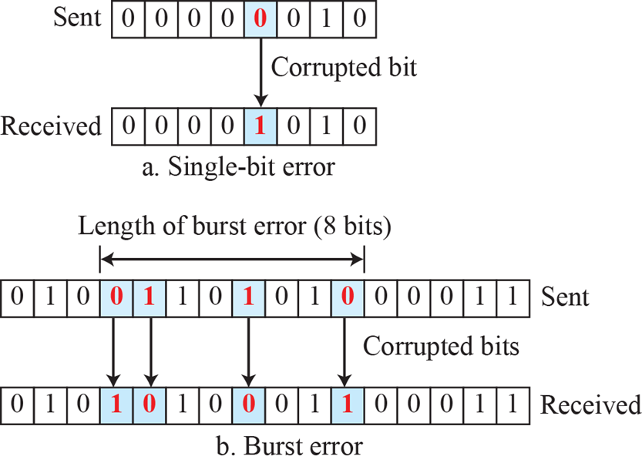
Single-bit and burst error

Slide 7
Error-detection and correction schemes
The general idea for achieving error detection and correction
Transmitter
adding some redundancy to a message
Receiver :
checking consistency of the delivered message,
recovering data that has been determined to be corrupted

Slide 8
Error-detection and correction schemes
Backward error correction
an error detection scheme is combined with requests for retransmission of erroneous data
Automatic repeat request (ARQ)
Data Link layer and above
Forward error correction
The sender encodes the data using an error-correcting code (ECC) prior to transmission
The redundancy added by the code is used by the receiver to recover the original data

Slide 9
Error-detection and correction schemes
Hybrid schemes (Hybrid ARQ)
two basic approaches
Messages are always transmitted with FEC parity data (and error-detection redundancy)
A receiver requests retransmission using ARQ only if the parity data was not sufficient for successful decoding
Messages are transmitted without parity data (only with error-detection information)
a receiver requests FEC information from the transmitter using ARQ if it detects an error

Slide 10
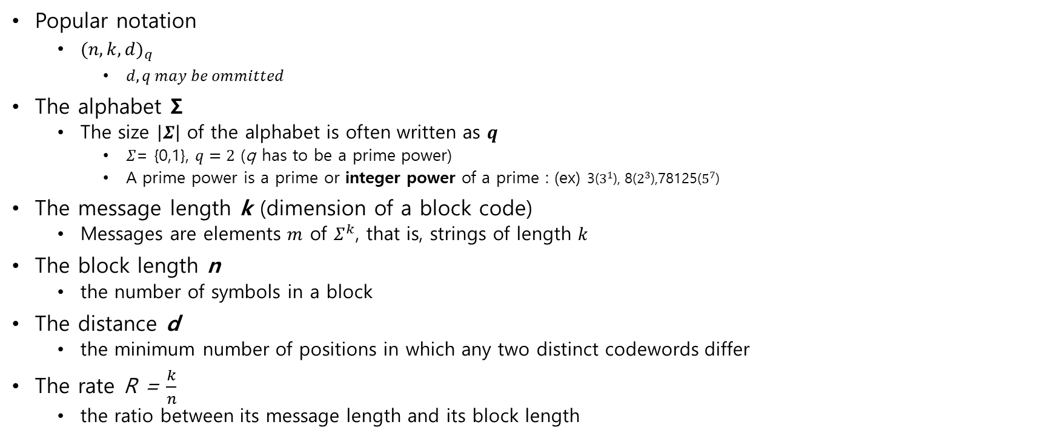
The block code and its parameters
Popular notation
${(n,k,d)}_{q}$
$d,q may be ommitted$
The alphabet Σ
The size $\left|Σ\right|$ of the alphabet is often written as $q$
$Σ$= {0,1}, $q=2$ (q has to be a prime power)
A prime power is a prime or integer power of a prime : (ex) 3($3^{1}$), 8($2^{3}$),78125($5^{7}$)
The message length k (dimension of a block code)
Messages are elements $m$ of $Σ^{k}$, that is, strings of length $k$
The block length n
the number of symbols in a block
The distance d
the minimum number of positions in which any two distinct codewords differ
The rate R = $\frac{k}{n}$
the ratio between its message length and its block length

Slide 11

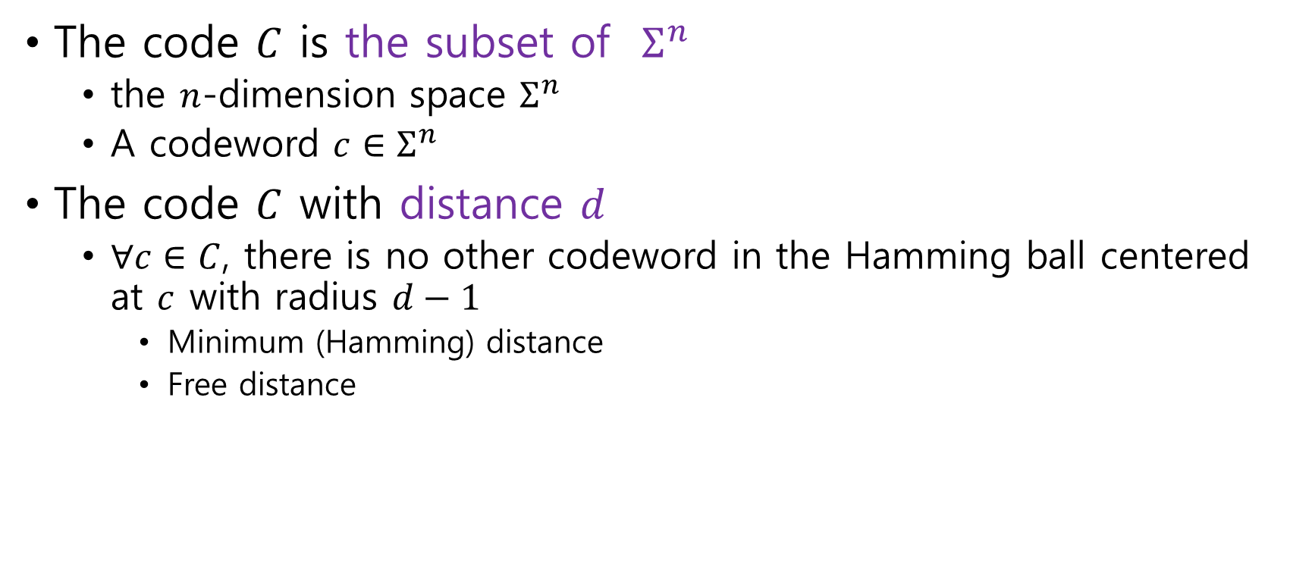



Error detection and correction properties
The code $C$ is the subset of $Σ^{n}$
the $n$-dimension space $Σ^{n}$
A codeword $c∈Σ^{n}$
The code $C$ with distance $d$
$∀c∈C$, there is no other codeword in the Hamming ball centered at $c$ with radius $d−1$
Minimum (Hamming) distance
Free distance
$$c$$
$$d−1$$
$$d$$
$c′$ $∉C$

Slide 12
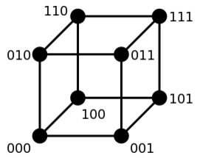
Error detection and correction properties
Hamming distance
The number of positions at which the corresponding symbols are different
Hamming weight
The number of symbols that are different from the zero-symbol of the alphabet (Σ)
The Hamming distance from the all-zero string of the same length

Slide 13

Error detection and correction properties
The code $C$with (minimum) distance $d$
$C$ can detect $d−1$ errors
$C$ can correct $\left\lfloor \frac{d−1}{2}\right\rfloor$ errors
$C$ can detect $d−1$ erasures
Erasure : eliminated symbols intentionally

Slide 14
Error Detection Schemes

Slide 15
Error detection schemes
Error detection is most realized using a suitable hash function (or checksum algorithm).
A hash function adds a fixed-length tag to a message,
Receivers verify the delivered message by recomputing the tag and comparing it with the one provided.

Slide 16
Error Detection Schemes Repetition codes
Given a stream of data to be transmitted, the data are divided into blocks of bits
Each block is transmitted some predetermined number of times
Example
4-bit block, repeating three times
1011
1011 1011 1011

Slide 17
Error detection schemes Parity bits
A parity bit is a bit that is added to a group of source bits to ensure that the number of set bits (bits with value 1) in the outcome is even or odd.
It is a very simple scheme that can be used to detect single or any other odd number of errors in the output.

Slide 18
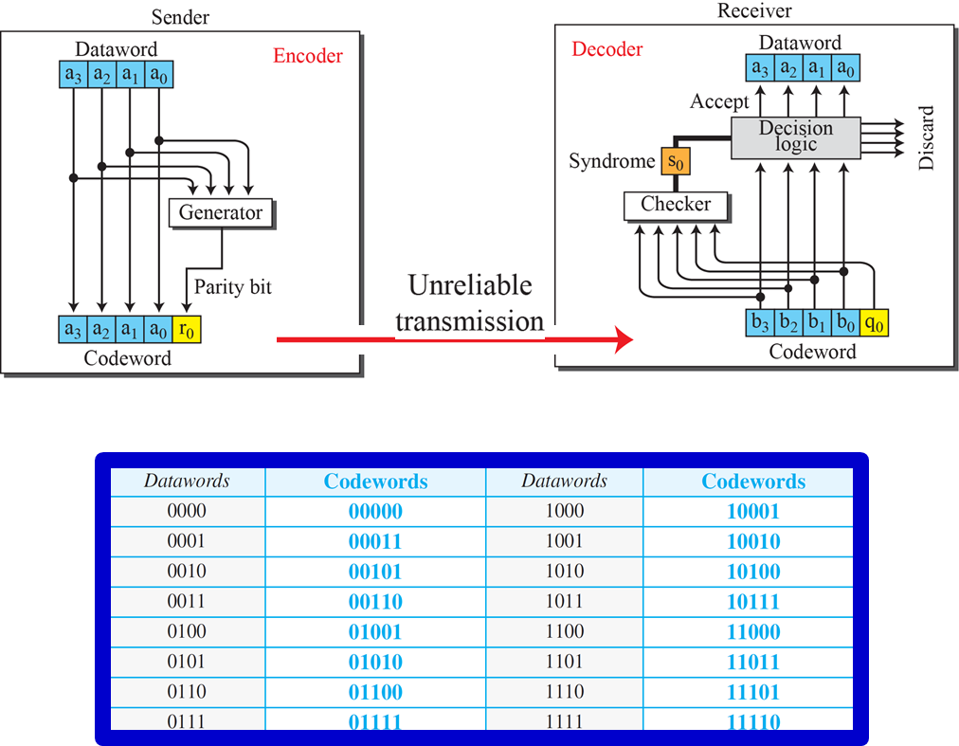

Simple parity-check code $${(5,4,2)}_{2}$$

Slide 19
Error detection schemes Cyclic redundancy checks (CRCs)
A non-secure hash function designed to detect accidental changes to digital data in computer networks
Binary division
Finite Algebra Theory (Galois Fields)
The divisor
a generator polynomial
the dividend
the input data
The remainder
The result of (polynomial long) division

Slide 20
Interleaving
Shuffling source symbols across several code words

Slide 21
Interleaving
Interleaving FEC coded data can reduce the all or nothing properties of transmitted FEC codes when the channel errors tend to occur in bursts

Slide 22
Interleaving
Many communication channels are not memoryless: errors typically occur in bursts rather than independently
If the number of errors within a code word exceeds the error-correcting code's capability, it fails to recover the original code word

Slide 23
Interleaving
Interleaving mitigates this problem by shuffling source symbols across several code words, thereby creating a more uniform distribution of errors
interleaving is widely used for burst error-correction
Disadvantages of interleaving
Use of interleaving techniques increases total delay

Slide 24
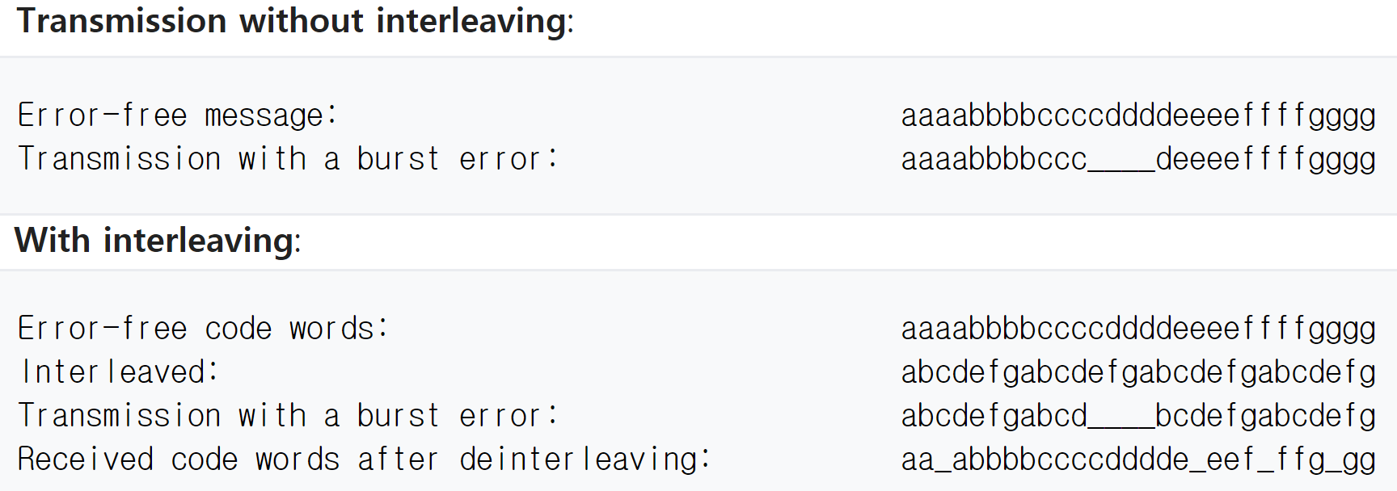
Interleaving : Example

Slide 25
Forward Error Correction (FEC)
Block codes
Binary Convolutional Codes (BCC)

Slide 26
Forward Error Correction
FEC could be said to work by "averaging noise“
since each data bit affects many transmitted symbols, the corruption of some symbols by noise usually allows the original user data to be extracted from the other
This all-or-nothing tendency (the cliff effect)
Because of this "risk-pooling" effect, digital communication systems that use FEC tend to work well above a certain minimum SNR and not at all below it

Slide 27
Forward Error Correction FEC Type
The two main categories of FEC codes
Block codes work on fixed-size blocks (packets) of bits or symbols of predetermined size
Hard-decision algorithms
For every input and output signal, a hard decision is made whether it corresponds to a one or a zero bit
Convolutional codes work on bit or symbol streams of arbitrary length
They are most often soft decoded with the Viterbi algorithm
Soft-decision algorithms

Slide 28
Forward Error Correction
Block Coding

Slide 29
Reed–Solomon codes
informational

Slide 30
Forward Error Correction Reed–Solomon codes
Reed–Solomon codes were introduced by Irving S. Reed and Gustave Solomon in 1960
Consumer technologies
CDs, DVDs, Blu-ray Discs, QR codes
Data transmission technologies
DSL and WiMAX,
Broadcast systems
DVB and ATSC,
Storage systems
RAID 6
Satellite communication.

Slide 31
Forward Error Correction
Binary Convolutional Coding (BCC)

Slide 32
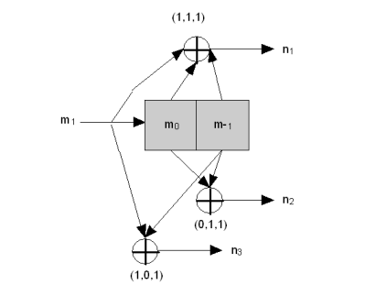
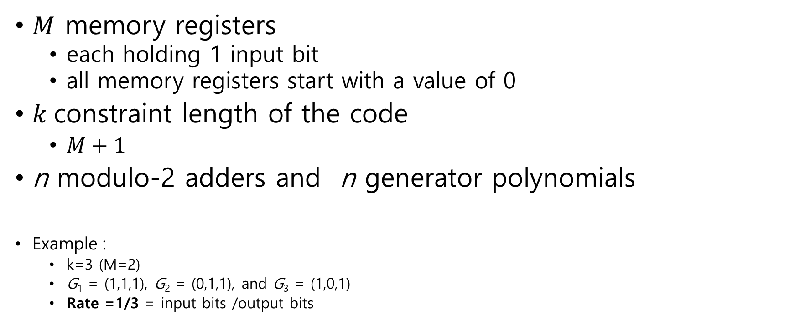
Forward Error Correction Binary Convolutional Coding (BCC)
$M$ memory registers
each holding 1 input bit
all memory registers start with a value of 0
$k$constraint length of the code
$M+1$
n modulo-2 adders and n generator polynomials
Example :
k=3 (M=2)
G₁ = (1,1,1), G₂ = (0,1,1), and G₃ = (1,0,1)
Rate =1/3 = input bits /output bits

Slide 33
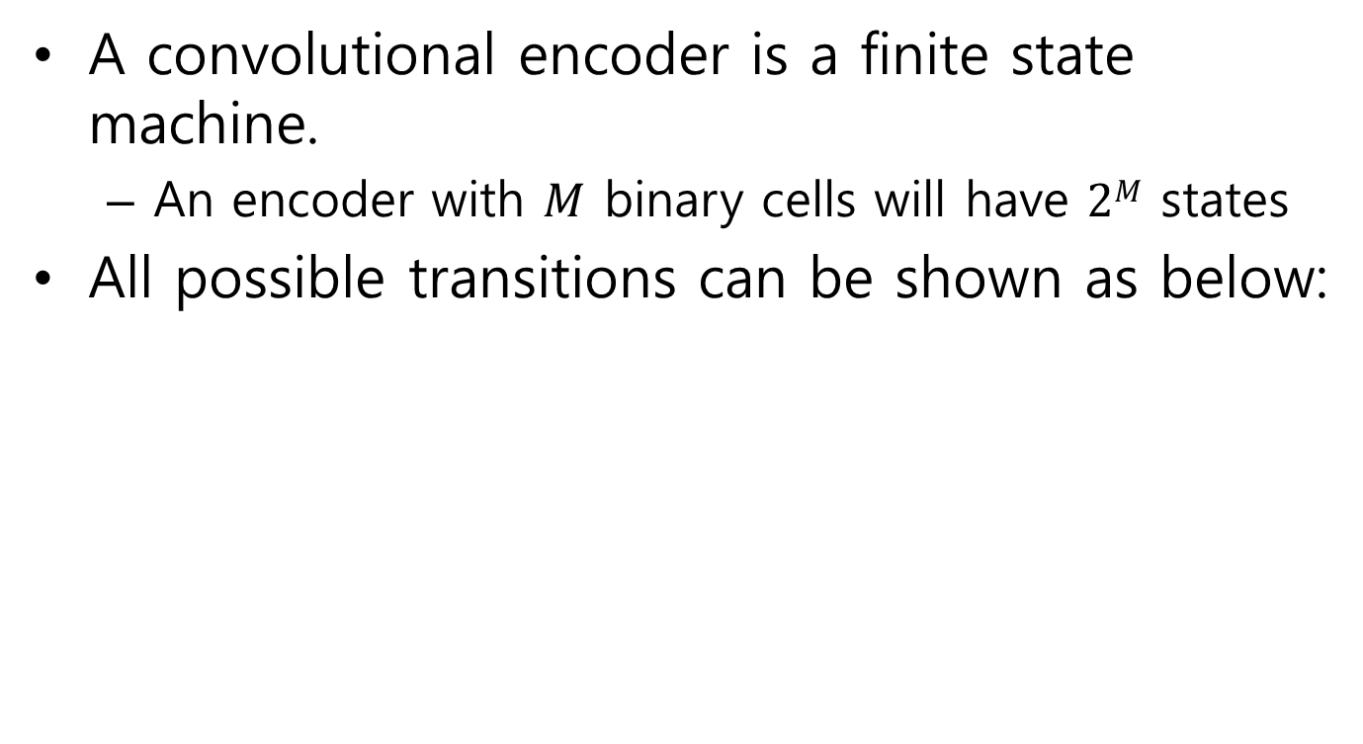
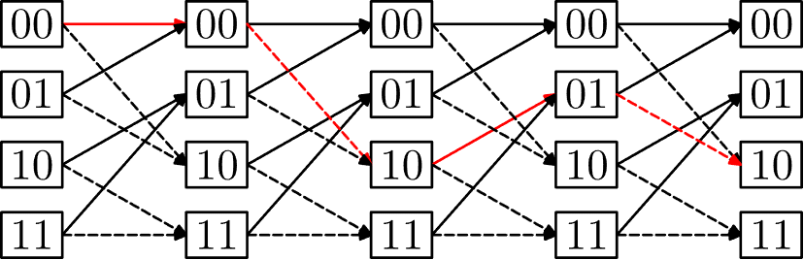


Forward Error Correction Binary Convolutional Encoding : Trellis diagram
A binary convolutional encoder is a finite state machine.
An encoder with $M$ binary cells will have $2M$ states
All possible transitions can be shown as below:
$$m_{0},m_{−1}$$
0
(000)
$$m_{0},m_{−1}$$
1
(101)
1
(101)
0
(110)
1
(010)
Input (0) : The solid lines, input (1) the dashed lines
Initial State (00) : Input string (0101), Output string(000 101 110 010)
A path through the trellis is shown as a red line

Slide 34
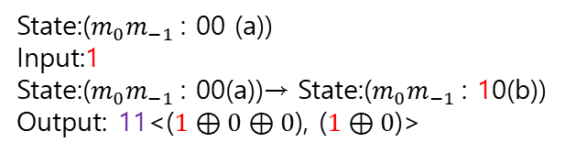

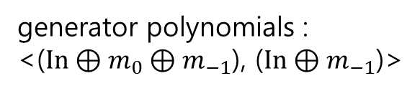



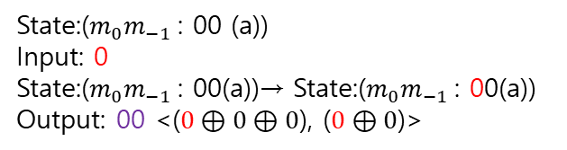
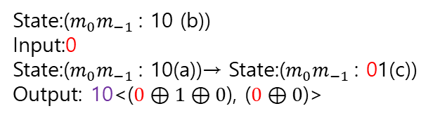
Forward Error Correction Binary Convolutional Encoding : Trellis diagram
a(00)
00
a(00)
binary Convolutional Encoder
11
State:($m_{0}m_{−1}$: 00 (a))
Input: 0
State:($m_{0}m_{−1}$: 00(a))→ State:($m_{0}m_{−1}$: 00(a))
Output: 00 <($0⊕0⊕0$), ($0⊕0$)>
b(10)
10
c(01)
$$m_{0}m_{−1}$$
(states)
(00):a
(10):b
(01):c
(11):d
01
$$m_{0}$$
d(11)
$$m_{−1}$$
State:($m_{0}m_{−1}$: 00 (a))
Input:1
State:($m_{0}m_{−1}$: 00(a))→ State:($m_{0}m_{−1}$: 10(b))
Output: 11<($1⊕0⊕0$), ($1⊕0$)>
State:($m_{0}m_{−1}$: 10 (b))
Input:0
State:($m_{0}m_{−1}$: 10(a))→ State:($m_{0}m_{−1}$: 01(c))
Output: 10<($0⊕1⊕0$), ($0⊕0$)>
generator polynomials :
<($In⊕m_{0}⊕m_{−1}$), ($In⊕m_{−1}$)>
State:($m_{0}m_{−1}$: 10 (b))
Input:1
State:($m_{0}m_{−1}$: 10(a))→ State:($m_{0}m_{−1}$: 11(d))
Output: 01<($1⊕1⊕0$), ($1⊕0$)>

Slide 35
Forward Error Correction Binary Convolutional decoding
The free distance (d) is the minimal Hamming distance between different encoded sequences

Slide 36
Forward Error Correction Binary Convolutional decoding : Viterbi algorithm
For relatively small values of k, the Viterbi algorithm is universally used as it provides maximum likelihood performance and is highly parallelizable.
Minimum Distance Decoding
Upon receiving the received sequence r, search for the path in the trellis that is closest (in Hamming distance) to r

Slide 37
Forward Error Correction Binary Convolutional decoding : Viterbi algorithm
Walk through the trellis
compute the Hamming distance between that branch of r and those in the trellis
i=3 (all possible paths)
00 00 00 / 11 10 11
00 00 11 / 11 10 00
00 11 10 / 11 01 01
00 11 01 / 11 01 10
r = 10 10 00 01 10 01
d=2 or 3
d=4 or 1
d=3 or 4
d=3 or 4
Tailing bits (00)
a.b.c.d(xx) -> a(00)

Slide 38
Forward Error Correction Binary Convolutional decoding : Viterbi algorithm
2. At each level,
consider the two paths entering the same node and are identical from this node onwards.
From these two paths, the one that is closer to r at this stage will still be so at any time in the future.
This path is retained, and the other path is discarded
One path will be saved for each node
Each survivor is associated with a metric of the accumulated Hamming distance

Slide 39
Forward Error Correction Binary Convolutional decoding : Viterbi algorithm
the survivors
i=3 (all possible paths)
00 00 00 or 11 10 11
00 00 11 or 11 10 00
00 11 10 or 11 01 01
00 11 01 or 11 01 10
r = 10 10 00 01 10 01
d=2 or 3
d=4 or 1
d=3 or 4
d=3 or 4

Slide 40
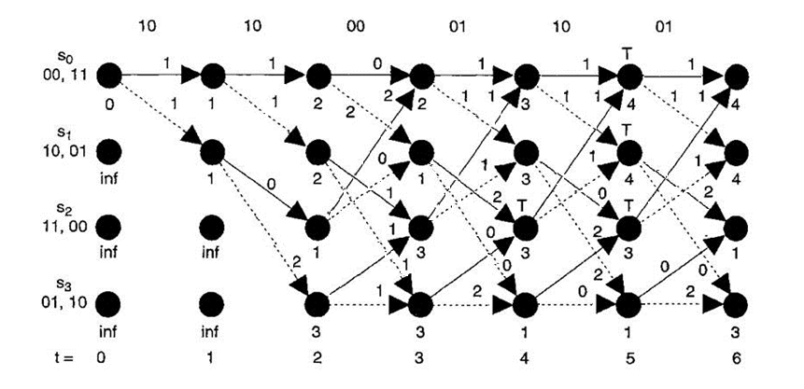
Forward Error Correction Binary Convolutional decoding : Viterbi algorithm
3. Carry out this process until the received sequence is considered completely.
Choose the survivor with the smallest Hamming distance
d for the branch
r = 10 10 00 01 10 01
s = 11 10 00 01 10 01
Message: 101110
101110

Slide 41
Puncturing
Removing some of the parity bits after encoding with an error-correction code (BCC)

Slide 42
Puncturing
Puncturing is the process of removing some of the parity bits after encoding with an error-correction code
Achieving a higher rate R (less redundancy)
A pre-defined pattern of puncturing is used in an encoder.
Erasures : removed bits and their position are known (pre-defined)
De-puncturing
De-puncturing inserts a dummy “zero” metric into the convolutional decoder on the receive side in place of the omitted bits.

Slide 43
Puncturing
With puncturing, the same decoder can be used regardless of how many bits have been punctured
Puncturing considerably increases the flexibility of the system without significantly increasing its complexity.

Slide 44
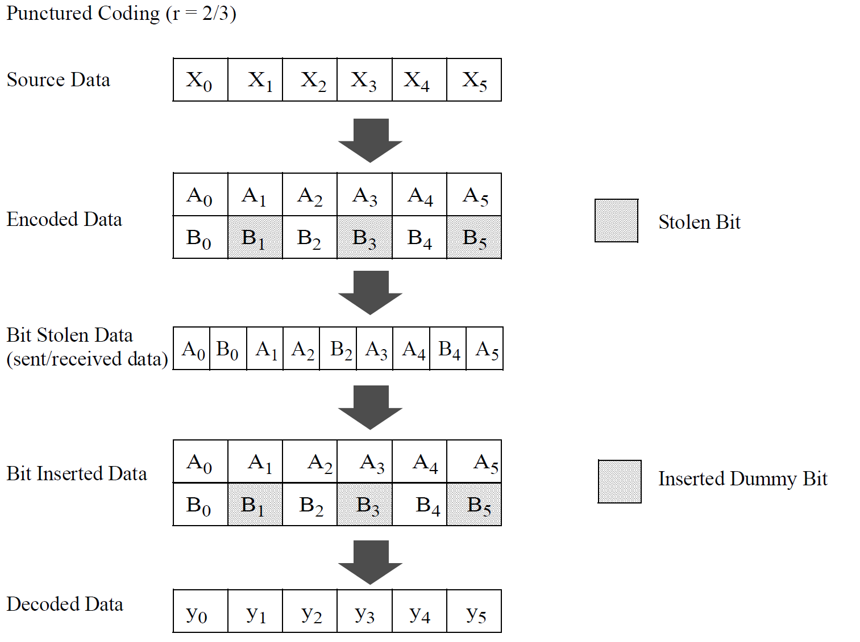
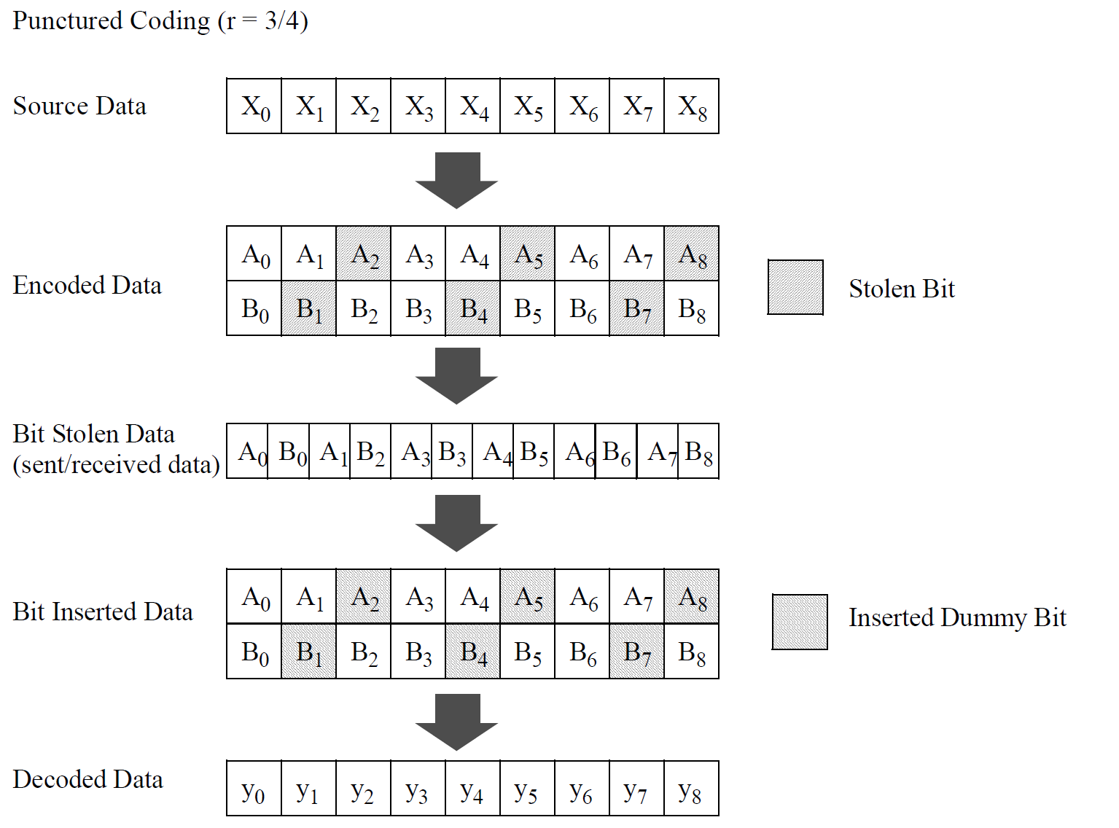
Puncturing IEEE 802.11-2020
The output of convolutional encoder (r=1/2)
Figure 17-9—Example of the bit-stealing and bit-insertion procedure (r = 3/4, 2/3)

Slide 45
Forward Error Correction
Low-density parity-check (LDPC)

Slide 46
Forward Error Correction Low-density parity-check (LDPC)
Low-density parity-check (LDPC)
Robert G. Gallager
PhD. Dissertation, MIT, 1960
LDPC codes functionally are defined by a sparse parity-check matrix.
the sparsity constraints : low-density of ‘1’s

Slide 47
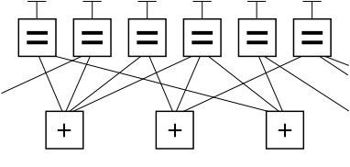
Forward Error Correction Low-density parity-check (LDPC)
Graphical representation of an (n, k) LDPC code
(Ignoring any lines going out of the picture)
there are eight possible six-bit strings corresponding to valid codewords:
(000000, 011001, 110010, 101011, 111100, 100101, 001110, 010111)
(variable node)
codeword
(factor node)
the graphical constraints
(parity-check matrix)
All values connecting to a factor node must sum to zero
https://en.wikipedia.org/wiki/Low-density_parity-check_code

Slide 48
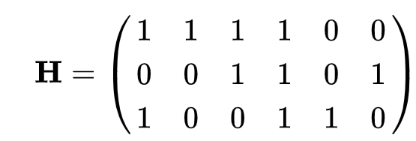
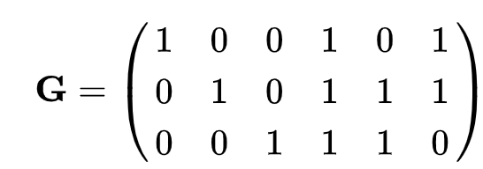
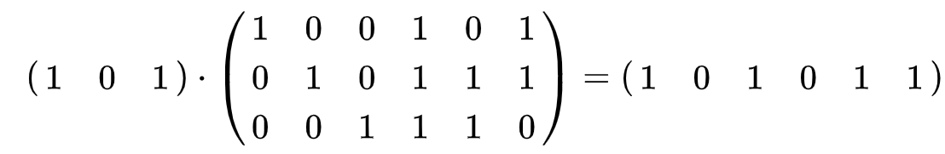
Forward Error Correction Low-density parity-check (LDPC)
Mapping H to G
111100
001101
100110
(000) 000000
(001) 001110 (010) 010111 (011) 011001
(100) 100101
(101) 101011 (110) 110010
(111) 111100
Input Data
Generator Matrix G
Code word
Identity Matrix (I)

Slide 49
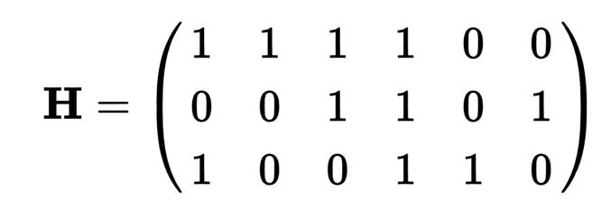
Forward Error Correction Low-density parity-check (LDPC)
The parity-check matrix representing this graph fragment :
A
B
C
A
B
C

Slide 50
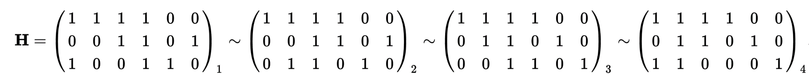
Forward Error Correction Low-density parity-check (LDPC)
This form $\left[−{P_{k}}^{T}|I_{n−k}\right]$ through basic row operations in GF(2):
(1) H
(2) Row 1 is added to row 3
(3) Row 2 and 3 are swapped
(4) Row 1 is added to row 3
Note that in the special case of this being a binary code P=-P
GF(2) is the Galois Field of two elements.

Slide 51
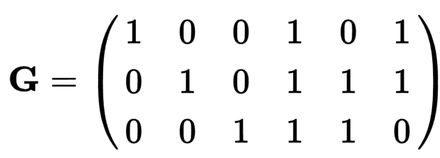

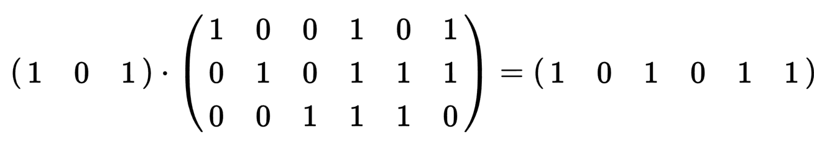




Forward Error Correction Low-density parity-check (LDPC)
The generator matrix G = $\left[I_{n−k}|P_{k}\right]$
111
011
110
1 0 1
1 1 1
1 1 0
${P_{k}}^{T}=$
$$P_{k}=$$
$$GH^{T}=0$$
1+0+0+1+0+0=2=0
0+0+0+1+0+1=2=0
0+0+0+1+1+0=2=0
(000) 000000
(001) 001110
(010) 010111
(011) 011001
(100) 100101
(101) 101011
(110) 110010
(111) 111100

Slide 52
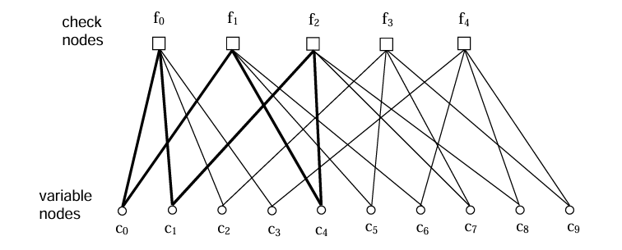
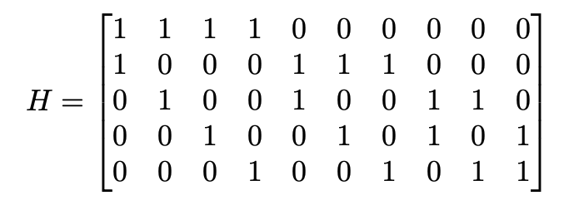
Forward Error Correction Graphical Representation of LDPC http://tuk88.free.fr/LDPC/ldpcchap.pdf
Fig. 1. Tanner graph for example code.

Slide 53
Forward Error Correction Decoding: LDPC
Each bit node is furnished an initial estimate of the probability it is a 1 from the soft output of the channel
The bit node broadcasts this initial estimate to the parity nodes on the lines connected to that bit node
University of California San Diego
https://acsweb.ucsd.edu/~afazelic/ece154c/ErrorCorrection-JackWolf.pdf

Slide 54

Forward Error Correction Decoding: LDPC
Initial estimate of the probabilities : Pr[c=1]
- the soft output of the channel
Pr[$B_{i}=1]$ [0.9 0.5 0.4 0.3 0.9 0.9]
0.9
0.5
0.4
0.3
0.9
0.9

Slide 55
Forward Error Correction Decoding: LDPC
Each parity node knows that there are an even number of 1’s in the bits connected to that node
Each parity node makes new estimate for the i-th bit node based upon all the other probabilities furnished to it
The probability of the parity node to be satisfied
Each parity node sends these new estimates (on the lines) back to the bit nodes

Slide 56
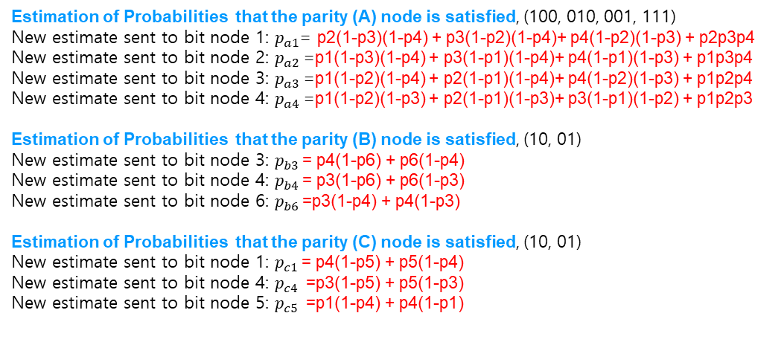
Forward Error Correction Decoding: LDPC
0.9
0.5
0.4
0.3
0.9
0.9
Estimation of Probabilities that the parity (A) node is satisfied, (100, 010, 001, 111)
New estimate sent to bit node 1: $p_{a1}$= p2(1-p3)(1-p4) + p3(1-p2)(1-p4)+ p4(1-p2)(1-p3) + p2p3p4
New estimate sent to bit node 2: $p_{a2}$=p1(1-p3)(1-p4) + p3(1-p1)(1-p4)+ p4(1-p1)(1-p3) + p1p3p4
New estimate sent to bit node 3: $p_{a3}$=p1(1-p2)(1-p4) + p2(1-p1)(1-p4)+ p4(1-p2)(1-p3) + p1p2p4
New estimate sent to bit node 4: $p_{a4}$=p1(1-p2)(1-p3) + p2(1-p1)(1-p3)+ p3(1-p1)(1-p2) + p1p2p3
Estimation of Probabilities that the parity (B) node is satisfied, (10, 01)
New estimate sent to bit node 3: $p_{b3}$= p4(1-p6) + p6(1-p4)
New estimate sent to bit node 4: $p_{b4}$= p3(1-p6) + p6(1-p3)
New estimate sent to bit node 6: $p_{b6}$=p3(1-p4) + p4(1-p3)
Estimation of Probabilities that the parity (C) node is satisfied, (10, 01)
New estimate sent to bit node 1: $p_{c1}$= p4(1-p5) + p5(1-p4)
New estimate sent to bit node 4: $p_{c4}$ =p3(1-p5) + p5(1-p3)
New estimate sent to bit node 5: $p_{c5}$ =p1(1-p4) + p4(1-p1)
0.5
0.4
0.3
0.3
0.9
0.9
0.3
0.4
0.9
0.9
B
C
Estimation of Probabilities that the parities are satisfied (even)
A
(A)
p’1= 0.5(1-0.4)(1-0.3) + 0.4(1-0.5)(1-0.3) +0.3(1-0.5)(1-0.4)+0.5*0.3*0.4=0.5
p’2= 0.9(1-0.4)(1-0.3) + 0.4(1-0.9)(1-0.3) +0.3(1-0.9)(1-0.4)+0.9*0.4*0.3=0.532
p’3= 0.9(1-0.5)(1-0.3) + 0.5(1-0.9)(1-0.3) +0.3(1-0.9)(1-0.5)+0.9*0.5*0.3=0.5
p’4= 0.9(1-0.5)(1-0.4) + 0.5(1-0.9)(1-0.4) +0.4(1-0.9)(1-0.5)+0.9*0.5*0.4=0.5
(B)
p’3= 0.3*(1-0.9) + 0.9*(1-0.3) =0.66
p’4= 0.4*(1-0.9) + 0.9*(1-0.4) =0.58
p’6= 0.3*(1-0.4) + 0.4*(1-0.3) =0.46
(C)
p’1= 0.3*(1-0.9) + 0.9*(1-0.3) =0.66
p’4= 0.9*(1-0.9) + 0.9*(1-0.9) =0.18
p’5= 0.9*(1-0.3) + 0.3*(1-0.9) =0.66

Slide 57
Forward Error Correction Decoding: LDPC
Each bit node calculates new probability for the i-th parity node based upon all the other estimates and the initial channel estimate
The bit node send new probabilities to the parity nodes on the lines connected to that bit node

Slide 58
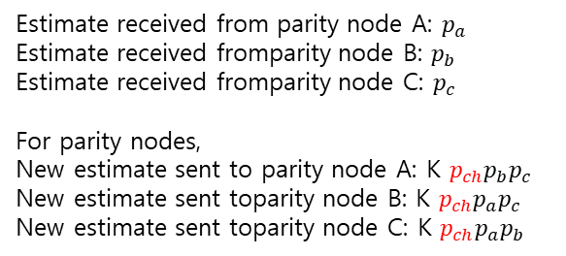
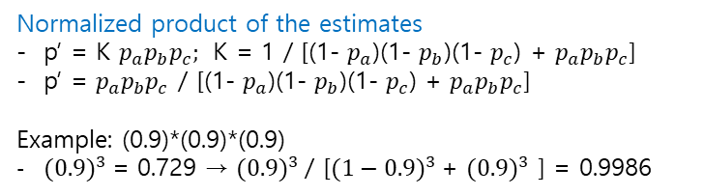
Forward Error Correction Decoding: LDPC
Estimate received from parity node A: $p_{a}$
Estimate received fromparity node B: $p_{b}$
Estimate received fromparity node C: $p_{c}$
For parity nodes,
New estimate sent to parity node A: K $p_{ch}p_{b}p_{c}$
New estimate sent toparity node B: K $p_{ch}p_{a}p_{c}$
New estimate sent toparity node C: K $p_{ch}p_{a}p_{b}$
channel
0.9
b1
0.535
0.5
0.5
0.66
0.58
0.66
0.18
0.5
0.66
A
B
0.46
C
Normalized product of the estimates
p’ = K $p_{a}p_{b}p_{c};$ K = 1 / [(1- $p_{a}$)(1- $p_{b}$)(1- $p_{c}$) + $p_{a}p_{b}p_{c}$]
p’ = $p_{a}p_{b}p_{c}$ / [(1- $p_{a}$)(1- $p_{b}$)(1- $p_{c}$) + $p_{a}p_{b}p_{c}$]
Example: (0.9)*(0.9)*(0.9)
${(0.9)}^{3}$= 0.729 → ${(0.9)}^{3}$/ [${(1−0.9)}^{3}$+ ${(0.9)}^{3}$ ] = 0.9986
Estimation of Probabilities for bit nodes: Pr[c=1]
(b1) Pch=0.9, Pa = 0.5 Pc= 0.93
Pa = 0.9*0.93 / [(1-0.9)(1-0.93)+0.9*0.93] = 0.837 / 0.844 = 0.99
Pc = 0.9*0.5 /[(1-0.9)(1-0.5)+0.9*0.5] = 0.45 / 0.5 = 0.9

Slide 59
Forward Error Correction Decoding: LDPC
Each bit node decides its final decision based upon the final estimation
The final estimation calculated from all estimates and the initial channel estimate
If final estimation > 0.5, then the bit is one.
Otherwise, the bit is zero.

Slide 60
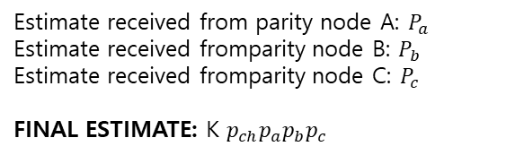
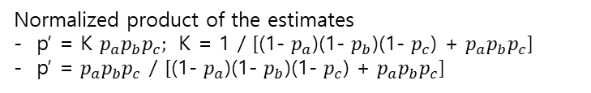
Forward Error Correction Decoding: LDPC
channel
Estimate received from parity node A: $P_{a}$
Estimate received fromparity node B: $P_{b}$
Estimate received fromparity node C: $P_{c}$
FINAL ESTIMATE: K $p_{ch}p_{a}p_{b}p_{c}$
0.9
b1
Normalized product of the estimates
p’ = K $p_{a}p_{b}p_{c};$ K = 1 / [(1- $p_{a}$)(1- $p_{b}$)(1- $p_{c}$) + $p_{a}p_{b}p_{c}$]
p’ = $p_{a}p_{b}p_{c}$ / [(1- $p_{a}$)(1- $p_{b}$)(1- $p_{c}$) + $p_{a}p_{b}p_{c}$]
0.535
0.5
0.5
0.66
0.58
0.66
0.18
0.5
0.66
A
B
0.46
C
The final estimation of the probability of each bits: Pr[b(x)=1]
b(1): Pch=0.9, Pa = 0.5 Pc= 0.66
FinalEst P[b(1)=1] = K*Pch*Pa*Pc
P[b(1)=1] = 0.9*0.5*0.66/[(1-0.9)(1-0.5)(1-0.66)+0.9*0.5*0.66]
= 0.4455 /[0.0175+0.4455] = 0.4455/0.463 = 0.96
P[b(1)=1] =0.96> 0.5 ; b(1)=1

